Slide 1
Introduction to Aggregation

Slide 2
Aggregation
Aggregation provides server side data manipulation to match what is found in the SQL language
It provides “stages” to filter, group, sort, transform and join data
Aggregation processing occurs on the server side, reducing network and client side overhead

Slide 3
Pipelines
Inputs
Filter
Group
Sort
Transform
Output
Aggregation pipelines are formulated in “stages” through which data flows.

Slide 4
Example

Slide 5
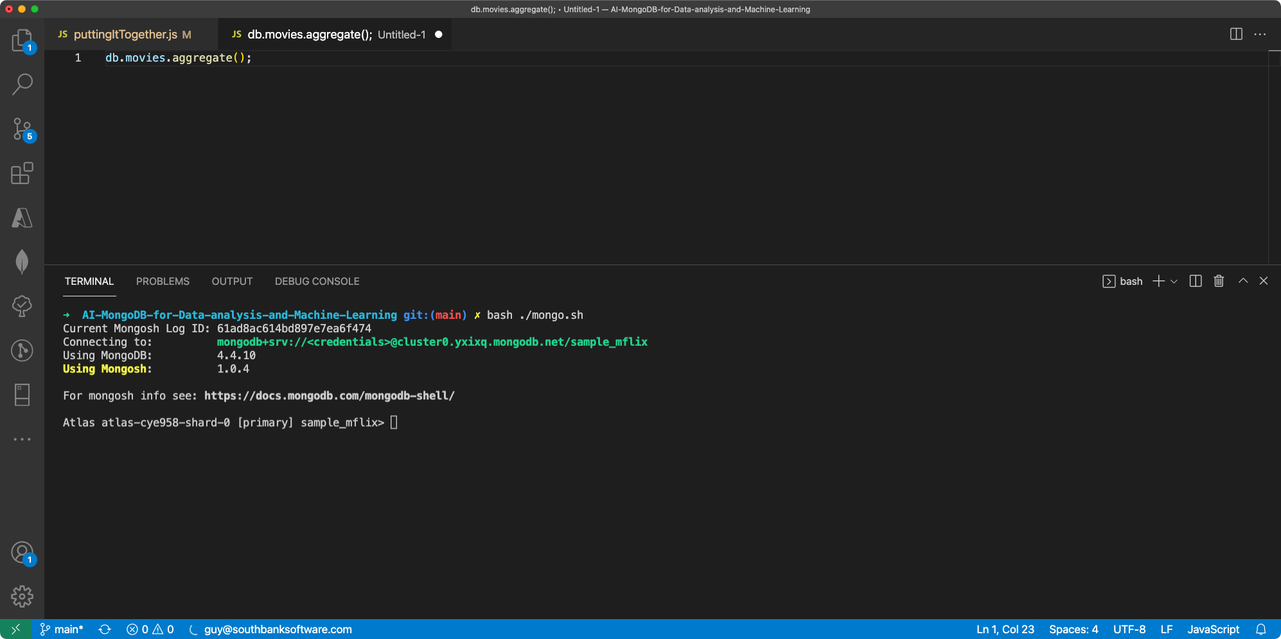

Slide 6
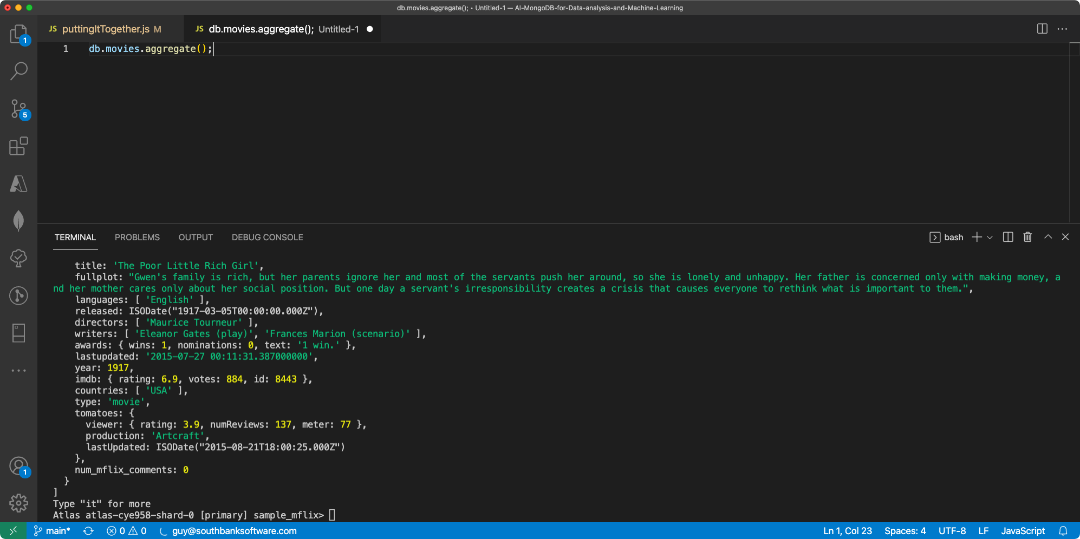

Slide 7
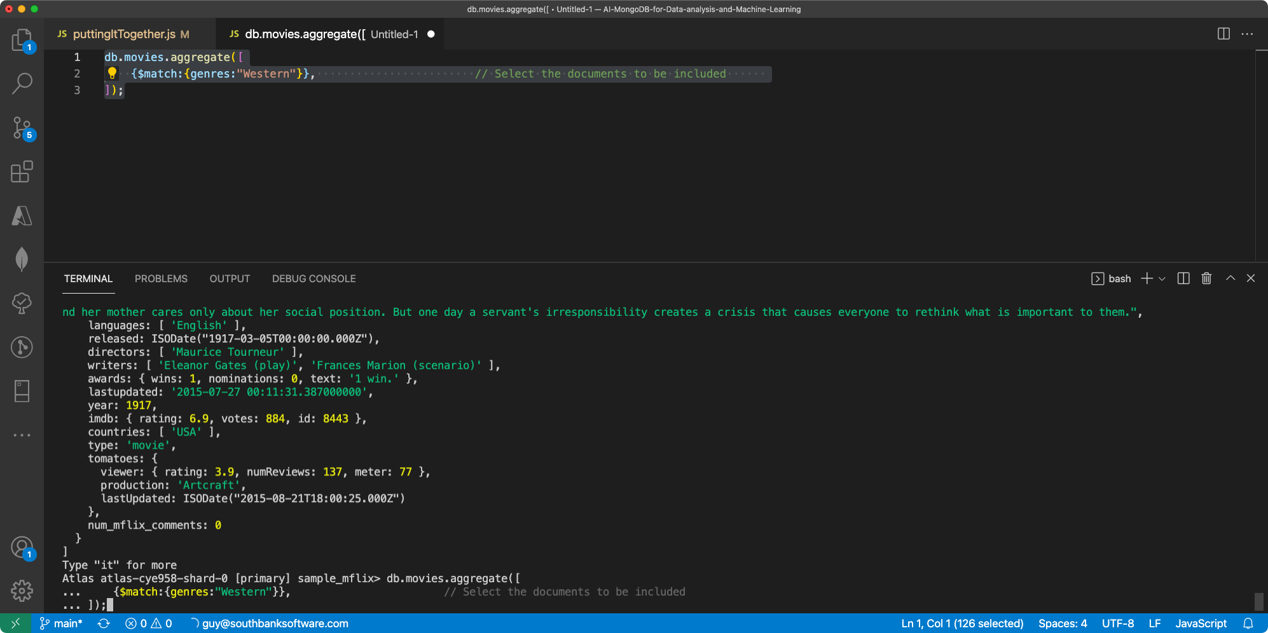

Slide 8
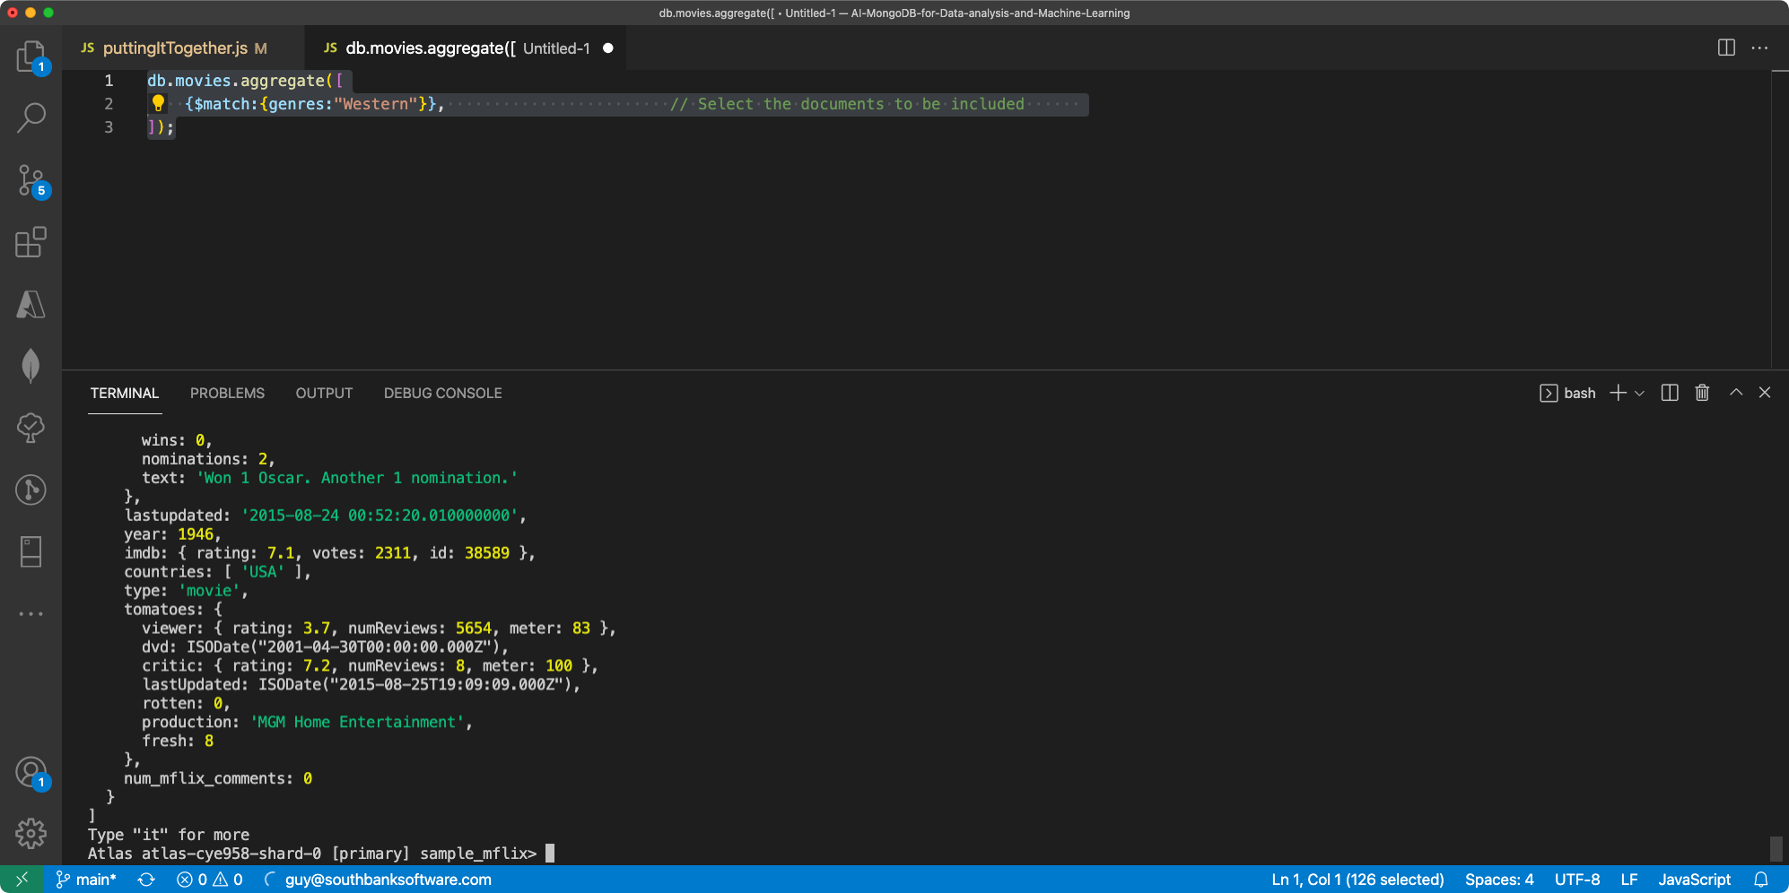

Slide 9
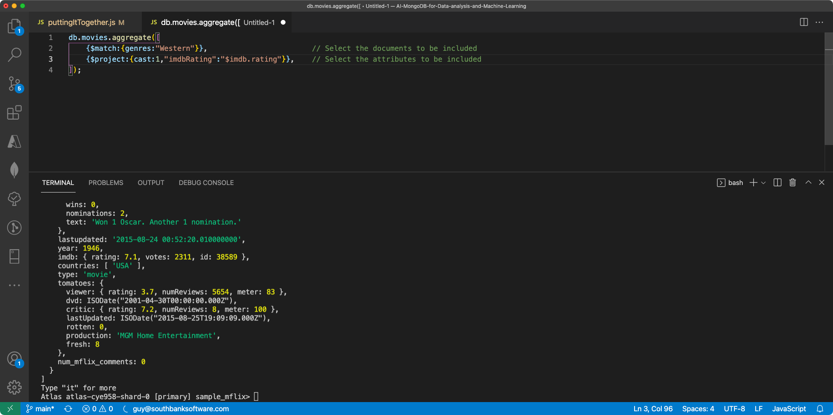

Slide 10
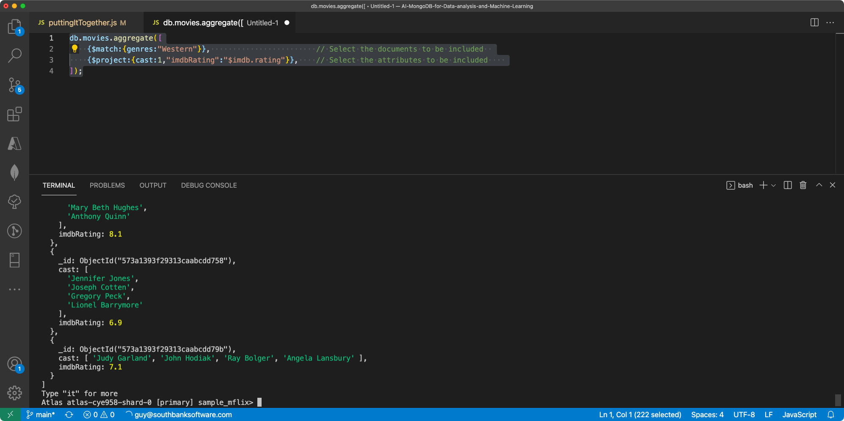

Slide 11
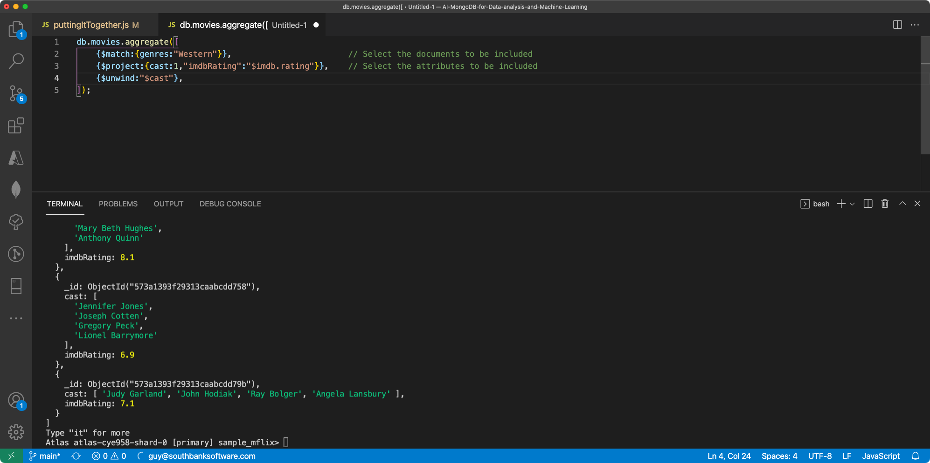

Slide 12
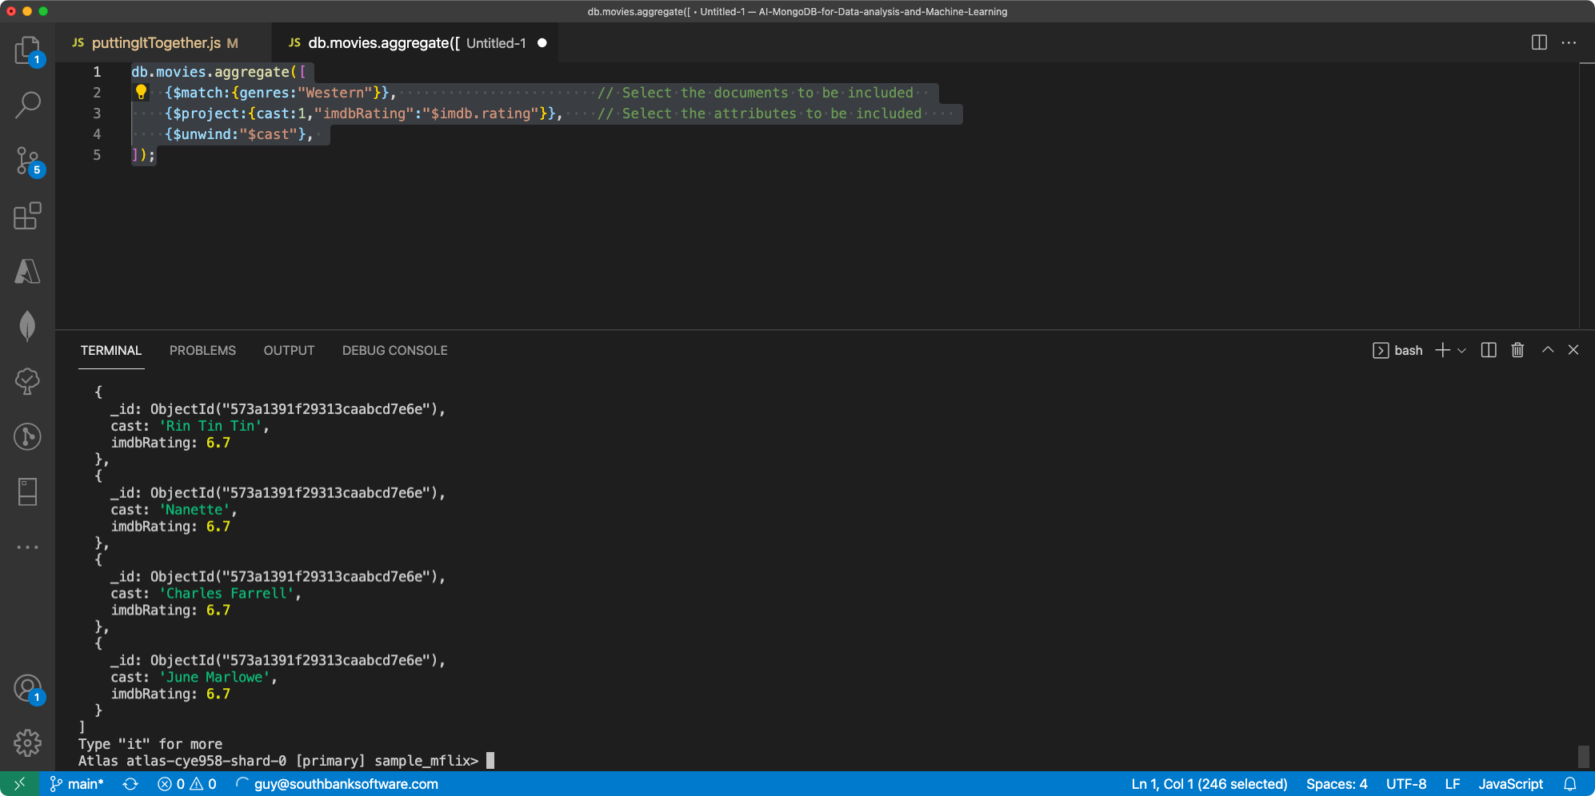

Slide 13
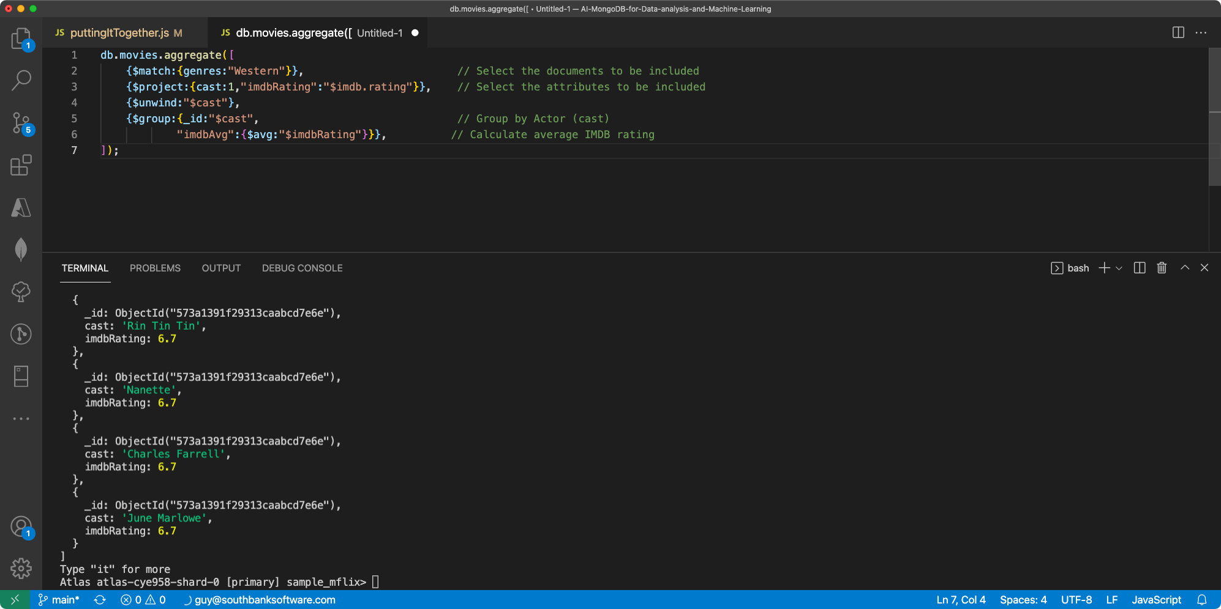

Slide 14
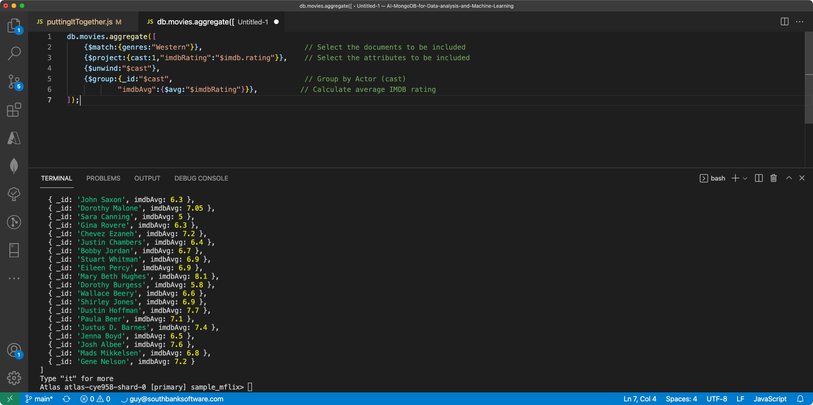

Slide 15
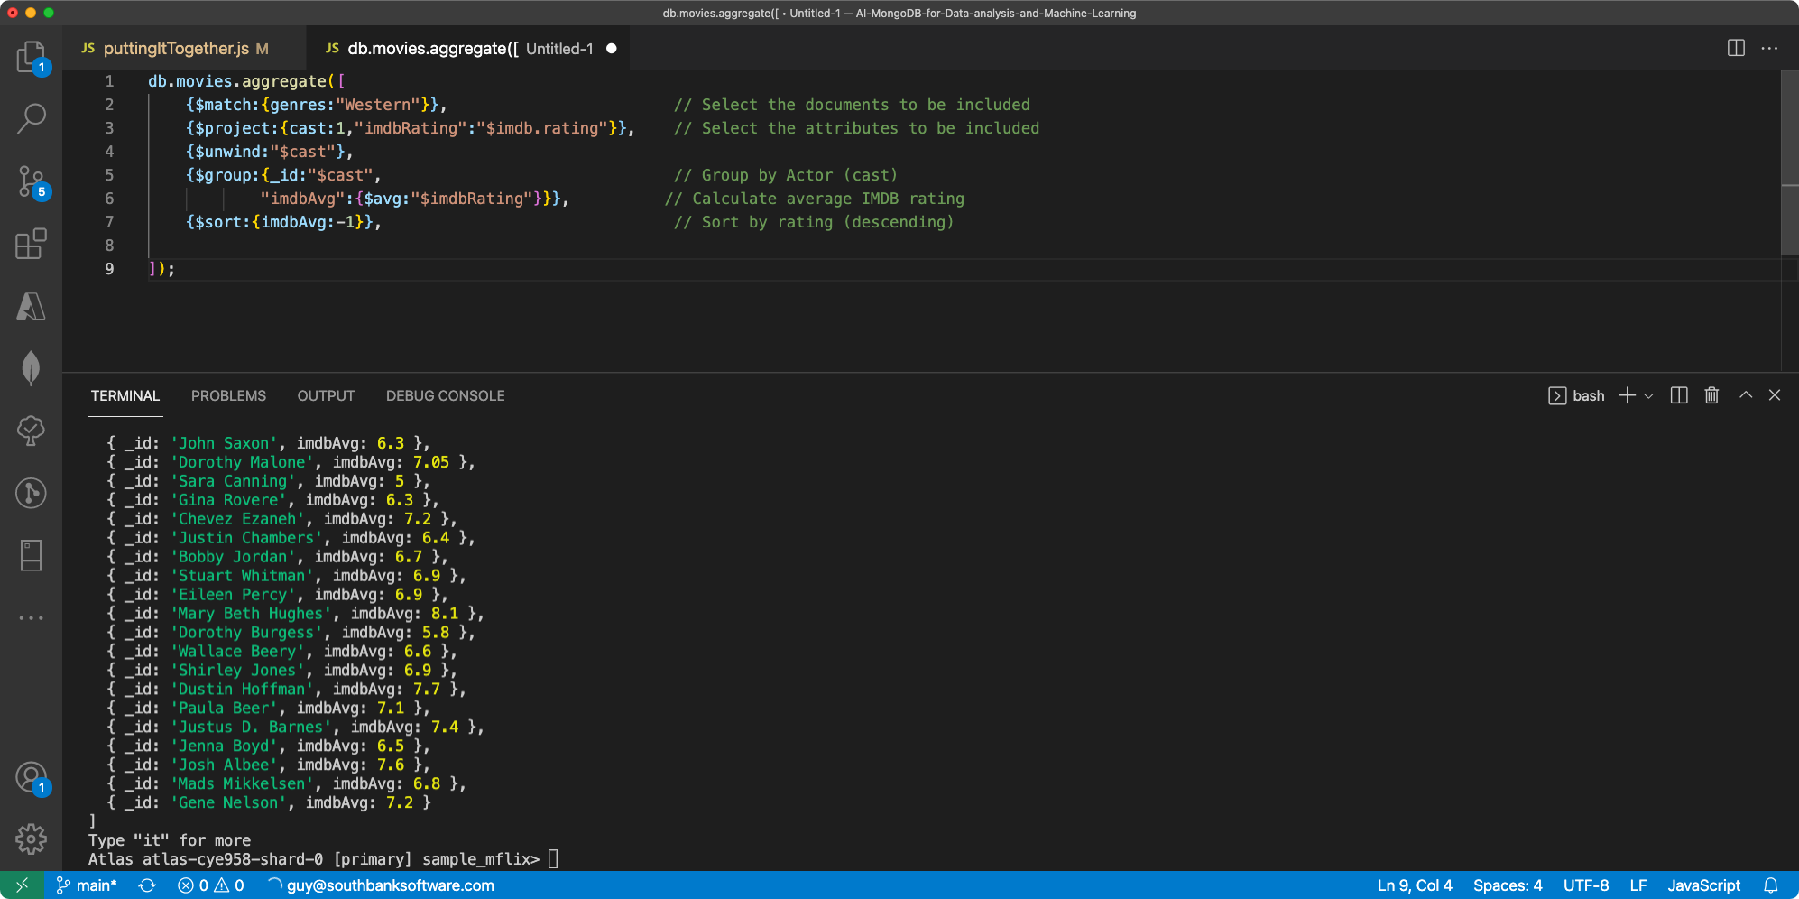

Slide 16
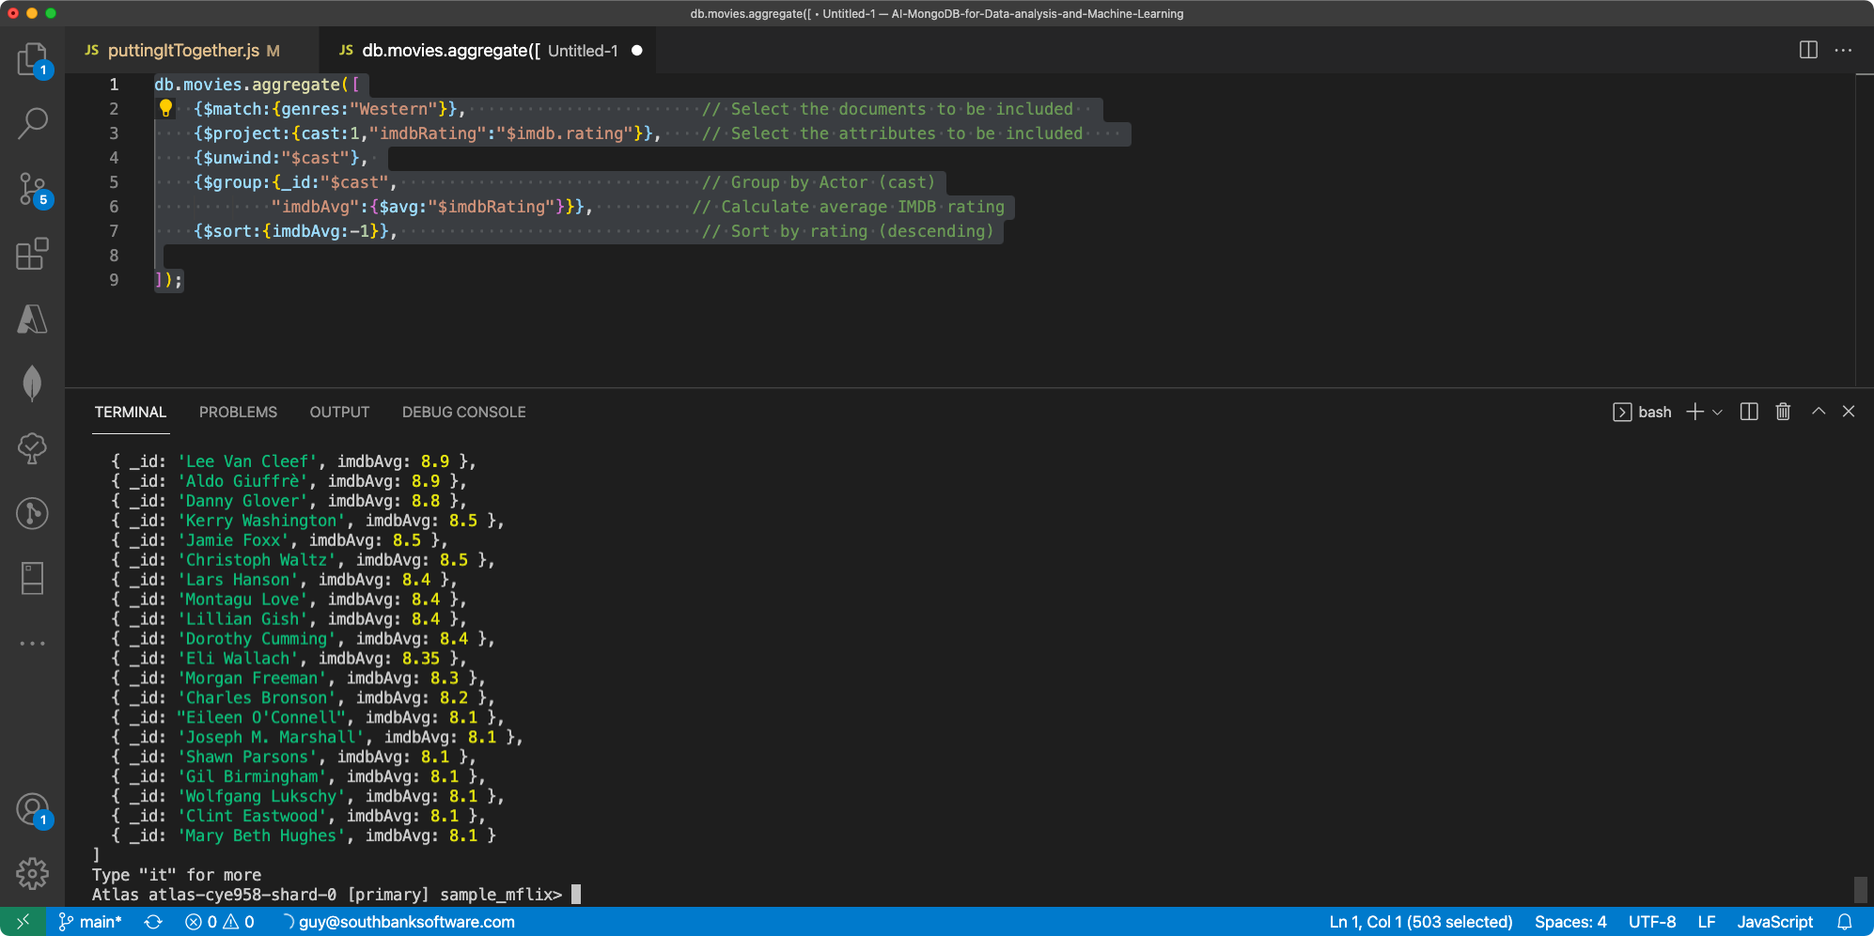

Slide 17
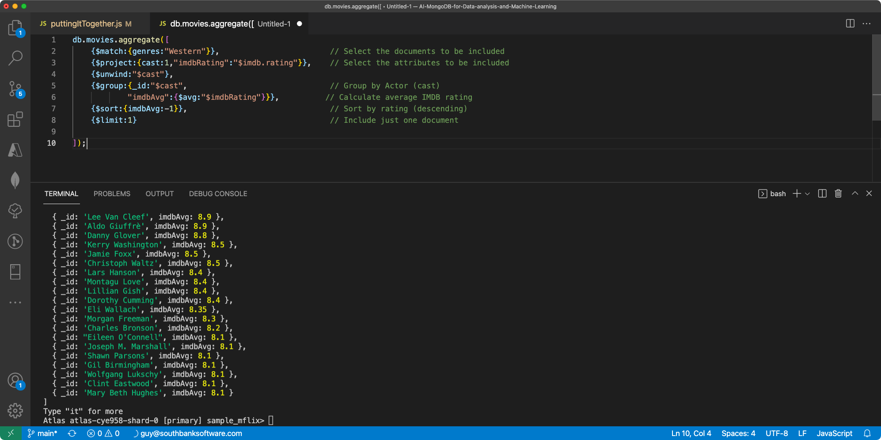

Slide 18
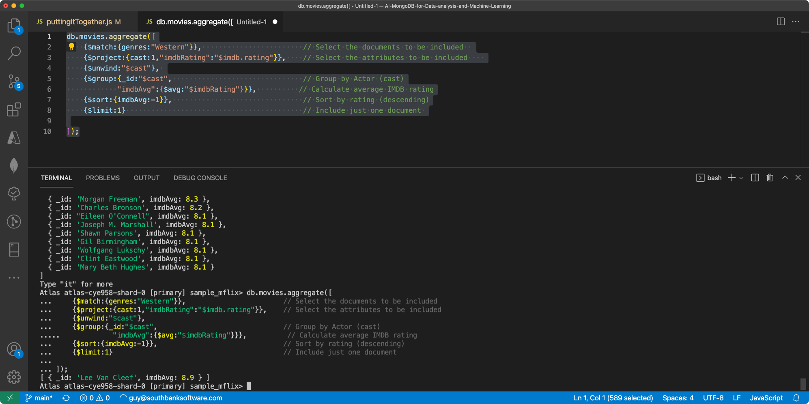

Slide 19
Tips for building aggregation pipelines
Whenever possible, pre-process data with aggregation before feeding into analytic tools
Use an editor that understands JavaScript syntax (Visual Studio code is good)
Carefully build up each stage one at a time.
Watch out for matching braces “{“ and “}”
Try the Compass aggregation pipeline builder or similar tools.

